Slide 1
EPA143A: Macroeconomics Week 2: Neoclassical Macro-Economics
Key assumptions of the neo-classical macro model:
In-built tendency toward full employment of labour & capital
Markets clear by means of the price mechanism; the model includes a labour market; a capital market; a market for goods & services; a loanable funds market; and a money market
Consumers are utility-maximisers and firms are profit-maximisers
Money is ‘neutral’; the classical dichotomy between the ‘real’ economy and the ‘financial’ economy holds true
Fiscal policy is not effective, because it leads to crowding out
Monetary policy has the task to contain/stabilise inflation

Slide 2
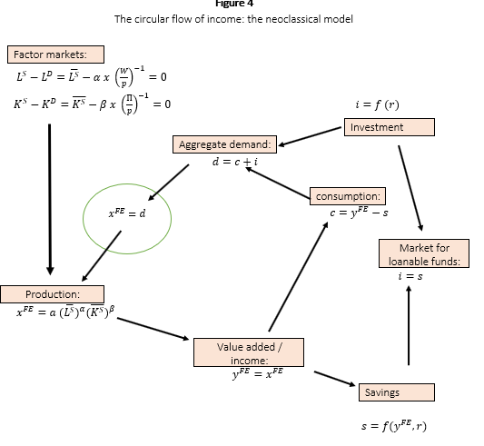
EPA143A: Macroeconomics Week 2:
The neoclassical
circular flow of income
We will 1st look at the
Factor markets

Slide 3
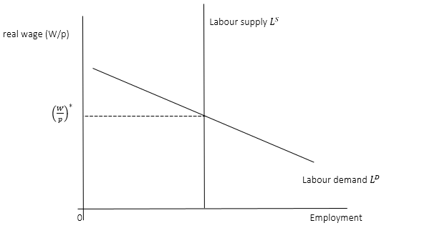
EPA143A: Macroeconomics Week 2: Neoclassical Macro-Economics
Factor markets:
Labour market
Price-clearing;
the price is (W/p)

Slide 4
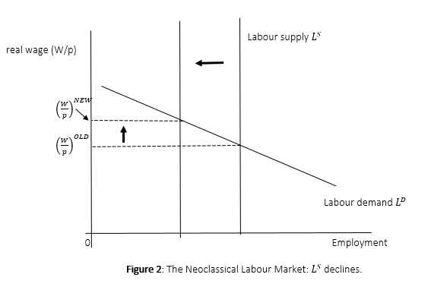
EPA143A: Macroeconomics Week 2: Neoclassical Macro-Economics
Factor markets:
Labour market:
Ls declines ->
equilibrium (W/p)
increases

Slide 5
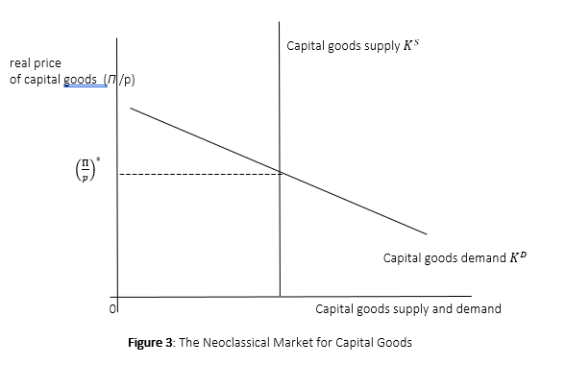
EPA143A: Macroeconomics Week 2: Neoclassical Macro-Economics
Factor markets:
Capital market
Capital = machines

Slide 6
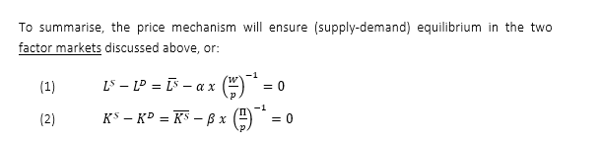
EPA143A: Macroeconomics Week 2: Neoclassical Macro-Economics
Price-clearing in factor markets ensures full employment of L and K:

Slide 7

EPA143A: Macroeconomics Week 2: Neoclassical Macro-Economics
Production:
Production -> income generation (wages + profits) ->
Income is partly saved (S) and partly consumed (C)
Savings constitute a leakage from the circular flow of income
Consumption -> demand for goods & services -> production

Slide 8
EPA143A: Macroeconomics Week 2:
The neoclassical
circular flow of income
(again)
Note: the savings leakage
into the market for
loanable funds

Slide 9
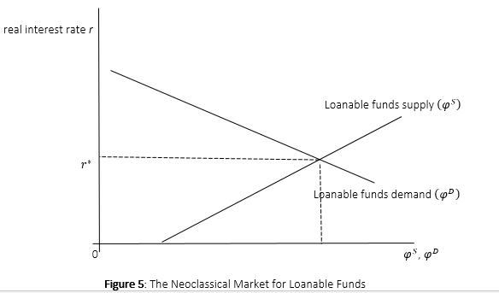
EPA143A: Macroeconomics Week 2: Neoclassical Macro-Economics
The market for loanable funds:
LFs = savings
(deposited in banks)
LFd = investment
(demand for loans)
‘Interest rate’ clearing

Slide 10
EPA143A: Macroeconomics Week 2: Neoclassical Macro-Economics
Full employment is guaranteed in this model,
because of the loanable funds market.
The leakage of income (savings) is “converted” into investment demand via the loanable funds market (banks):
If LFs > LFd, the interest rate goes down until LFs = LFd (equilibrium)
If LFs < LFd, the interest rate goes up until LFs = LFd (equilibrium)

Slide 11
EPA143A: Macroeconomics Week 2: Neoclassical Macro-Economics
The Money Market:
Money Supply M^{S} = Money Demand M^{D}
M^{S} = exogenous (= under the control of the central bank)
M^{D} = (1/v)*p*y (= stable transactions demand for money)
→ We obtain the Quantity Equation for Money: M^{S} *v = p*y

Slide 12
EPA143A: Macroeconomics Week 2: Neoclassical Macro-Economics
Money Market equilibrium: M^{S} = M^{D} = (1/v)*p*y
How is this brought about? p = (v*M^{S})/y
or in growth rates: g(p) = g(M^{S}) – g(y)
An example:
Suppose p = 1; v = 2 ; M^{S} = 50; and y^{FE} = 100. (v = constant)
What happens when M^{S} increases by 20% to 60?
p will increase →
p = 2*60/100 = 1.2 or g(p) = g(M^{S}) = 20% = inflation

Slide 13
EPA143A: Macroeconomics Week 2: Neoclassical Macro-Economics
The Money Market M^{s}_{old} M^{S}_{new}
p
M^{D}
M^{S}, M^{D}

Slide 14
EPA143A: Macroeconomics Week 2: Neoclassical Macro-Economics
Classical dichotomy between the real sphere and the money sphere:
Assume the labour market is in equilibrium at (W*/p*) and the loanable funds market is in equilibrium at (r*/p*).
Suppose the price level p increases by 20%. What happens? [ nothing ]
In the labour market: (W/p) will decline; labour demand will go up; but labour supply is constant; hence, the nominal wage W will rise until Ld = Ls again (at the original equilibrium real wage).
In the loanable funds market: (r/p) goes down; Loanable fund demand will go up, but loanable funds supply will go down; as a result, the nominal interest rate r will rise, until LFd = LFs again (at the original real interest rate).

Slide 15
EPA143A: Macroeconomics Week 2: Neoclassical Macro-Economics
Fiscal policy in the neoclassical model:
public spending crowds out private spending
Investment i = ip + ig
Assume that public investment ig is increased.
As a result, the government deficit goes up and the state has to borrow (from banks) in order to finance the increase in ig.
Result: the demand for loanable funds (LFd) increases.

Slide 16
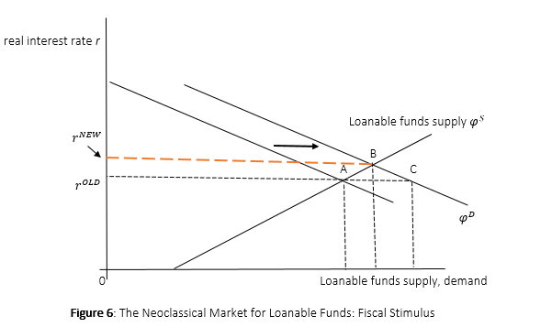
EPA143A: Macroeconomics Week 2:
Fiscal stimulus leads to:
LFd > LFs; increase in r
Higher r lowers private
(business) investment.
Higher r increases private
saving and lowers private
consumption
End result: higher public spending crowds out private spending; fiscal stimulus has no impact on aggregate demand, output, employment.

Slide 17

EPA143A: Macroeconomics Week 2: Neoclassical Macro-Economics
Monetary policy in the neoclassical macro model:
Money supply Ms = Money demand Md = (1/v)*p*y^{FE}
Ms = exogenous (under the control of the central bank)
Md = the transactions demand for money
y^{FE} = full-employment income (see circular flow of income)
Hence, we get: p = (v * Ms)/ y^{FE}
Role for monetary policy:
= to allow money supply to grow in lince with nominal GDP growth

Slide 18
EPA143A: Macroeconomics Week 2: Neoclassical Macro-Economics
Look at the exercises on:
The labour market (W2-1)
The loanable funds market (W2-2 & W2-3)
Monetary policy (W2-4)

Slide 19
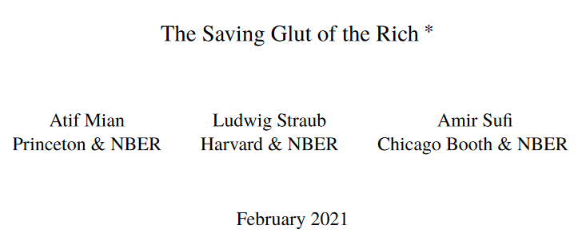
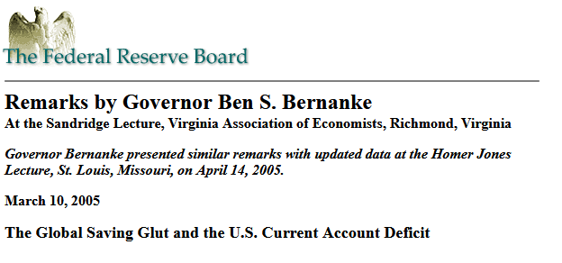

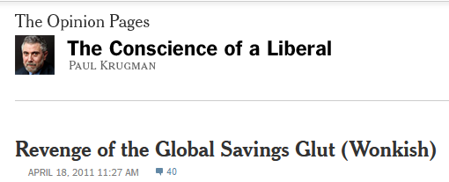
EPA143A: Macroeconomics Week 2: Neoclassical Macro-Economics

Slide 20
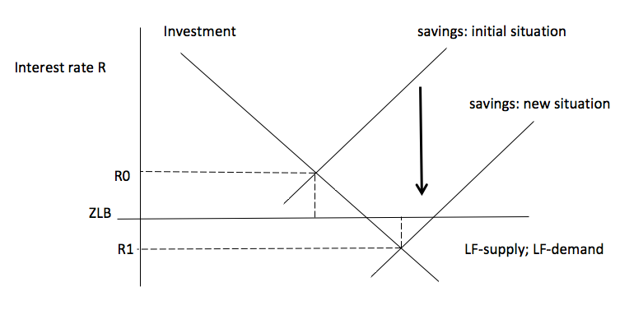
EPA143A: Macroeconomics Week 2: Neoclassical Macro-Economics
Figure 1:
The Loanable Funds
Market:
A Savings Glut
Causing Secular
Stagnation

Slide 21
EPA143A: Macroeconomics Week 2: Neoclassical Macro-Economics
Problems with the loanable funds market:
Loanable Funds Supply and Demand Are Not Independent Functions
Savings Do Not Fund Investment, Credit Does…
The Interest Rate Is a Monetary Policy Instrument, Not a Market-Clearing Price
The Manifest Absence of Finance and Financial Markets
See next page: the evidence is missing

Slide 22
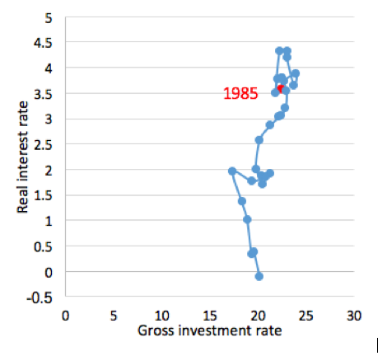
EPA143A: Macroeconomics Week 2: Neoclassical Macro-Economics
No evidence
of a global saving
(investment) glut.

